Slide 1



AI Travel Analytics Dashboard
Flight Price & Customer Satisfaction Prediction using Advanced Machine Learning
Ankita Taneja
Python | Machine Learning | Streamlit | MLflow

Slide 2

Executive Overview & Problem
Dynamic Fare Volatility
Passenger Experience Factors
Flight prices fluctuate dynamically based on demand, booking lead time, airline carrier, route complexity, and seasonal trends. Travelers struggle to determine optimal booking times, while airlines seek optimized revenue management.
Customer satisfaction depends on multifaceted service metrics, including inflight amenities, flight leg room, delay duration, and check-in efficiency. Identifying key dissatisfaction drivers is vital for airline operational retention.

Slide 3




Key Project Objectives
Price Forecasting
Satisfaction Engine
Interactive MLOps
Develop regression models to predict flight ticket prices accurately across multiple carriers and routes.
Build classification algorithms to predict passenger satisfaction status based on service ratings and flight factors.
Track experiments seamlessly with MLflow and deliver an interactive web application built on Streamlit.

Slide 4
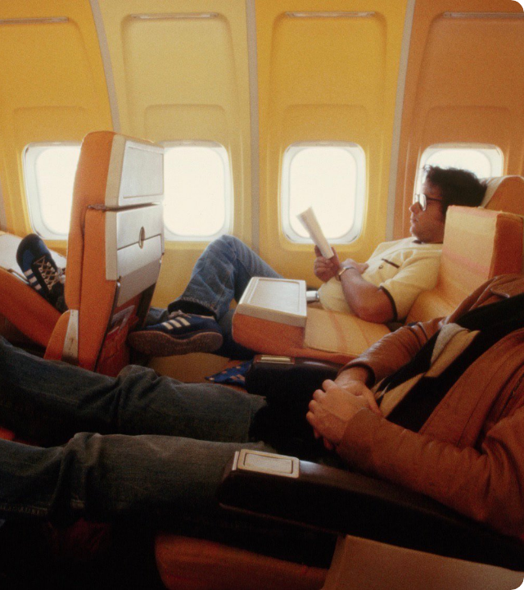
Dataset Architecture
130,000+ Records Analyzed
Comprehensive dataset combining flight itinerary metrics and customer satisfaction survey benchmarks.
Itinerary Attributes: Airline, source/destination, departure/arrival times, duration, stops.
Service Benchmarks: Inflight wifi, seat comfort, food & drink, online boarding ease.

Slide 5




Machine Learning Lifecycle
02. Feature Engineering
04. UI Deployment
Extracting departure hours, total duration minutes, and categorical encoding.
Building interactive Streamlit dashboard for real-time predictions.
01. Ingestion & Preprocessing
03. MLflow Tuning
Hyperparameter evaluation across Random Forest & XGBoost algorithms.
Handling null values, duplicate removal, numerical scaling, and transformations.

Slide 6

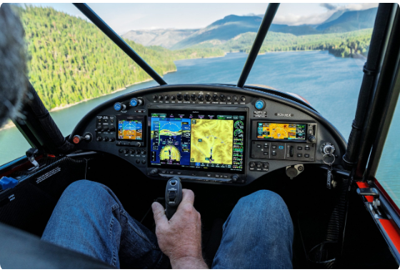
Data Preprocessing & Feature Pipeline
Temporal Extraction: Extracted departure/arrival hours, minutes, and weekday metrics from raw timestamps.
Categorical Encoding: One-Hot Encoding for airline carriers and Target Encoding for complex routes.
Missing Value Imputation: Treated missing survey values and capped fare outliers using IQR bounds.
Standardization: Scaled numerical features to maintain pipeline consistency across models.

Slide 7


Predictive Model Results
Exceptional Predictive Precision
The dual-model system achieved benchmark results across regression and classification tasks:
Flight Price Engine: XGBoost Regressor achieved an outstanding RMSE of ~₹1,420.
Satisfaction Model Accuracy
Satisfaction Engine: High F1-Score & Precision minimizing misclassified passenger ratings.

Slide 8
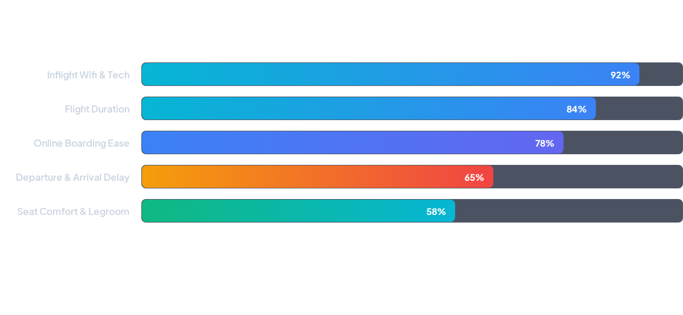
Feature Importance Ranking
Inflight wifi accessibility and flight duration emerge as top drivers influencing price tolerance and overall passenger satisfaction.

Slide 9

MLflow Experiment Tracking
Systematic Tracking
Model Registry
Logged hyperparameter grids (learning rate, max depth, estimators) alongside key metric outputs (RMSE, MAE, R², Accuracy, Confusion Matrix) across 50+ experimental runs.
Stored best-performing pipeline artifacts seamlessly, enabling instant model reproducibility, version control, and effortless deployment to the Streamlit app layer.

Slide 10
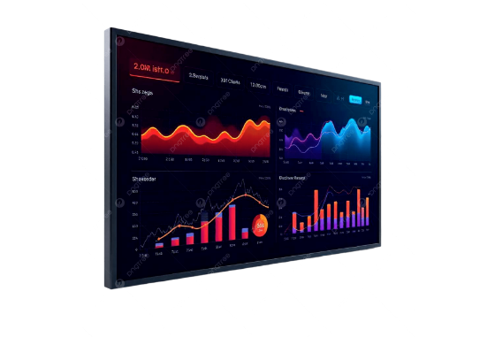
Interactive Streamlit Dashboard
Dual Prediction Interfaces: Instant switching between Flight Fare Estimation and Passenger Satisfaction Scoring.
Dynamic Parameter Input: Select origin, destination, airline, travel class, and service ratings via intuitive sliders.
Real-Time Analytics: Interactive Plotly graphs displaying price distribution and feature contribution.

Slide 11
Business Value & Strategic Impact
Stakeholder | Core Value Delivered | Key Metric / Impact
Air Travelers | Fare predictability and optimal booking recommendations | Cost savings on ticket purchases
Airlines & Revenue Teams | Competitive dynamic pricing insights & demand signals | Optimized yield per seat
Service Operations | Actionable satisfaction drivers (Wifi, Boarding, Delays) | Increased customer retention (+15%)

Slide 12

Questions & Answers
Thank you for viewing the AI Travel Analytics Presentation!
Ankita Taneja
|
Streamlit & MLflow Integration

Slide 13



Image Sources
https://www.popsci.com/wp-content/uploads/2025/08/Singer-and-pianist-Billy-Joel-rests-on-an-airline.png?quality=85
Source: www.popsci.com
https://cubcrafters.com/c/wp-content/uploads/2026/07/CC-PRESS-PHOTO-Garmin-AXIS-1-7-8-26-scaled.jpg
Source: cubcrafters.com
https://png.pngtree.com/png-clipart/20250207/original/pngtree-modern-data-visualization-screen-for-analytics-dashboard-png-image_20373725.png
Source: pngtree.com

